Slide 1
Lecture 7 Software Testing CSC301-Winter 2011
Hesam C. Esfahani
hesam@cs.toronto.edu

Slide 2
Outline
Introduction to Testing
Definition
Rationale
Some Types of Testing
Black-Box , White-Box, Reliability, Security, Regression Testing
Test Process Management
V Model - for Classical Software Development:
TDD – for Agile Software Development:
Unit Testing
Acceptance Testing
Formal Verification

Slide 3
Definition of Software Testing
Software Testing is the process of
Evaluating an attribute or capability of a program or system
Determining that a system meets its requirements
Fining defects
Exploring and understanding the status of the benefits and risks associated with the release of a software system

Slide 4
Some Different Types of Testing
Acceptance Testing
Black Box Testing
White Box Testing
Compatibility Testing
Conformance Testing
Functional Testing
Integration Testing
Load Testing
Performance Testing
Regression Testing
Smoke Testing
Stress Testing
Security Testing
Unit Testing
This isn't all of it, there is a lot more

Slide 5

Why Test?
Q: If all software is released to customers with faults, why should we spend so much time, effort, and money on testing?
Considering the potential costs of Delaying the Release of a Software Product
New products: The first to the market often sells better than superior products that are released later.

Slide 6
Cost to fix faults
It is commonly believed that the earlier a defect is found the cheaper it is to fix it.
Cost to fix a defect |  | Time detected
 |  | Requirements | Architecture | Construction | System test | Post-release
Time introduced | Requirements | 1× | 3× | 5 – 10× | 10× | 10 – 100×
 | Architecture | - | 1× | 10× | 15× | 25 – 100×
 | Construction | - | - | 1× | 10× | 10 – 25×

Slide 7
Beta Testing
Beta Testing
Customers test for free!
Seems to give you test cases representative of customer use.
Helps to determine what is most important to the customers.
Can do more configuration (environment) testing than in your testing lab.
Disadvantages:
Beta testers might have a particular perspective to the system, which result in not catching diverse system bugs.
Beta testers usually won’t report: usability problems, bugs they don’t understand and bugs that seem obvious.
Most beta testers are sometimes “techies” who have a higher tolerance of bugs. They do not represent the average customer.
Takes much more time and effort to handle a user reported bug.

Slide 8
General Testing Approaches
High-level approaches to testing that can be applied to the specific testing techniques
Positive and Negative Testing
Positive testing
Is intended to verify that a software system conforms to its stated requirements
Does the system “fit for purpose”?
Negative Testing
Is intended to assure that the system does NOT do what it is supposed to do
Black Box and White Box Testing
Experienced Based Testing
Is intended to design and perform effective tests
As suggested by its name, the skill is based on the experience

Slide 9
General Testing Approaches: Black Box Testing
Input
Black Box
Output
Used to test functional parts of a program.
The tester has no prior knowledge to the internal workings of the software other than what it is supposed to output.
Advantages
Unbiased, no programming knowledge needed
Test cases can be made very early on after specs are done.
Disadvantages
Can't identify all possible test cases
Can be redundant and cannot possibly test every single possible path.

Slide 10
General Testing Approaches: White Box Testing
Used to test the structural parts of the software.
The tester has explicit knowledge about the internal workings of the software and the programming language its written in.
Knowing how the software is supposed to work, the tester chooses specific paths and determines the appropriate output.
While white-box testing can be applied at the unit, integration and system levels of the software testing process, it is usually done at the unit level
1
2
3
4
5
6
program flow graph

Slide 11
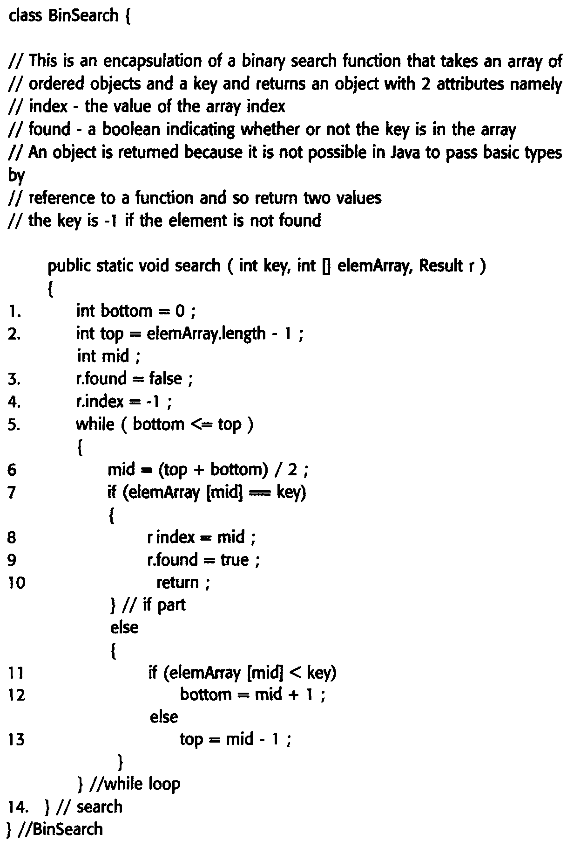
White Box Testing Example: Binary search pseudo-code

Slide 12
Binary search flow graph

Slide 13
White Box Testing example – Cont.
Independent Paths
1, 2, 3, 4, 5, 6, 7, 8, 9, 10, 14
1, 2, 3, 4, 5, 14
1, 2, 3, 4, 5, 6, 7, 11, 12, 5, …
1, 2, 3, 4, 6, 7, 2, 11, 13, 5, …
Test cases should be derived so that all of these paths are executed
Advantages:
Helps with optimizing code
Can be very thorough
Disadvantages:
Cannot detect missing parts of the specifications or missing requirements.
State explosion problem

Slide 14
Specific Testing Techniques
Performance Testing
Load Testing
Stress Testing
Endurance Testing
Security Testing
Confidentiality
Integrity
Authentication
Availability
Authorization
Non-repudiation
Regression Testing
Unit Testing
Integration Testing
System Testing

Slide 15
Performance Testing
Software performance testing is used to determine the speed or effectiveness of a computer, network, software program or device under particular circumstances
Performance testing is used to make sure that because of the software, system performance should not degrade.
Sometimes, specifications don't mention how optimal they want the software to be.
Should not take an infinite amount of time or infinite resources to run.
Benchmarks!
Used to test performance on a typical system.
Gives averages on how a low-end and high-end system would run given the software.

Slide 16
Performance Testing
Load Testing
Understand the behavior of the application under a specific expected load
A load can be expected concurrent number of users on the application
Highlights any bottlenecks in the application software (e.g. DB, App Server)
Stress Testing
Understand the upper limits of capacity within the application landscape.
Determine the application's robustness in terms of extreme load
Determine if the application will perform sufficiently if the current load goes well above the expected maximum
Endurance Testing
Determine if the application can sustain the continuous expected load
Find out performance degradation
To ensure that the throughput and/or response times after some long period of sustained activity are as good or better than at the beginning of the test

Slide 17
Security Testing
Software flaws leave huge gaping holes for hackers.
Companies worldwide often face security attacks.
Having high quality and reliable code helps a lot.
Needs to cover:
Confidentiality
Integrity
Authentication
Availability
Authorization
Non-repudiation
Software flaws leave huge gaping holes for hackers.
Companies worldwide often face security attacks.
Having high quality and reliable code helps a lot.
Needs to cover:
Confidentiality – Preventing disclosure of private info
Integrity – Ensuring that correct information is being received
Authentication - Establishing the identity of the user
Availability – Assuring info to be ready for use when expected by authorized users
Authorization – Only allowing authorized people (Access Control)
Non-repudiation – A measure intended to prevent the later denial that an action happened, or a communication that took place etc. (time stamping)
Taxonomy of Security Testing
Requirements level security analysis; Security trade-off analysis
Vulnerability Scan; Vulnerability Assessment
Security Assessment; Audit; Review

Slide 18
Regression Testing
Software Regression: is a software bug which makes a feature stop functioning as intended after a certain event (e.g. a system upgrade)
When you make new changes to software.
The change may break in your program.
An old bug which you may have fixed arises again.
Regression testing is a quality control method where it:
Checks to see whether new code will compile.
Checks to see if the unmodified code still works.
Can be (and is strongly recommended to be) automated
Regression testing is an integral part of the XP
Design documents are partly replaced by extensive, repeatable, and automated testing of the entire software package at every stage of development
Advantages
Since you test every time you add something new, you can easily find what caused the error.
Disadvantages
In large scale projects, doing a regression test could take a long time.
What is Software Performance Regression?
Notes:
Whenever a piece of code is changed it is possible that bugs have been introduced to it or previously working code is now broken. New bugs/defects can be introduced at every change or old bugs/defects may be reopened.

Slide 19
Test Process management
Classical Software Development
Testing in Waterfall development
Testing in V-Model
Testing in RUP
Agile Software Development
TDD – Test Driven Development

Slide 20
Management and Planning of Testing classical approach
Senior Management
Testing Manager
Design Team(s)
Testing Team(s)
Development Team(s)
Test Team Leader
Analysis Team(s)
Development Leader
Requirements Team(s)
Tester
Test Analyst
Development Team
Tester
Test Analyst
Tester
Test Analyst

Slide 21
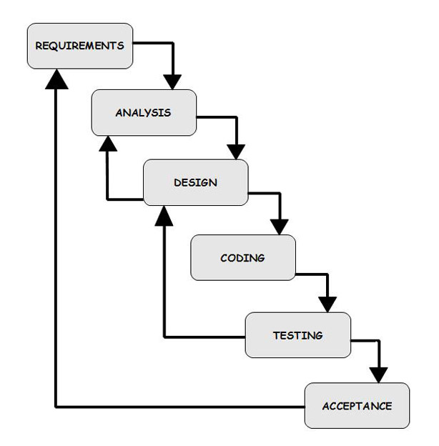
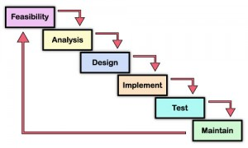
Testing in Waterfall model

Slide 22
Testing in V-Model
Requirements
Plan Acceptance Tests
Acceptance Testing
Specification
Plan System Tests
System Testing
Design
Plan Integration Tests
Integration Testing
Plan Unit Tests
Code
Unit Testing

Slide 23
Unit Testing
Testing individual units of source code to determine if they are fit for use.
What is a unit of code?
A unit is the smallest testable part of an application
Unit tests are typically written and run by software developers to ensure that code meets its design and behaves as intended
A unit test provides a strict, written contract that the piece of code must satisfy
Frameworks:
Started with SUnit for Smalltalk, written by Kent Beck
You're probably familiar with JUnit.
Benefits of Unit Testing:
To isolate each part of the program and show that the individual parts are correct
Facilitates Change
Simplifies Integration
Documentation
A link to the list of Unit Testing Frameworks !!
Notes:
By testing the parts of a program first and then testing the sum of its parts, integration testing becomes much easier.
Unit testing provides a sort of living documentation of the system. Developers looking to learn what functionality is provided by a unit and how to use it can look at the unit tests to gain a basic understanding of the unit's API.

Slide 24
Testing in V-Model
Requirements
Plan Acceptance Tests
Acceptance Testing
Specification
Plan System Tests
System Testing
Design
Plan Integration Tests
Integration Testing
Plan Unit Tests
Code
Unit Testing
24

Slide 25
Integration Testing
Combining units of system and testing them as a group
It occurs after unit testing and before system testing
Takes as its input modules that have been unit tested
Groups them in larger aggregates
Applies tests defined in an integration test plan to those aggregates
Delivers as its output the integrated system ready for system testing.
Purpose
Testing functionality, reliability, and performance of Major Design Components
E.g. separate subsystems of overall system
Major approaches
Top-down testing
The top integrated modules are tested and the branch of the module is tested step by step until the end of the related module.
Bottom-up testing
The lowest level components are tested first, then used to facilitate the testing of higher level components
Notes:
Bottom Up Testing is an approach to integrated testing where
Top Down Testing

Slide 26
Sample Integration Test Plan
Link 1
Link

Slide 27
Testing in V-Model
Requirements
Plan Acceptance Tests
Acceptance Testing
Specification
Plan System Tests
System Testing
Design
Plan Integration Tests
Integration Testing
Plan Unit Tests
Code
Unit Testing
27

Slide 28
System Testing
Testing a complete, integrated system to verify it matches its requirements (user requirements and system requirements)
Tests that can be performed in System Testing:
GUI software testing
Usability testing
Performance testing
Compatibility testing
Error handling testing
Load testing
Volume testing
Stress testing
Security testing
Scalability testing
Sanity testing
Smoke testing
Exploratory testing
Ad hoc testing
Regression testing
Reliability testing
Installation testing
Maintenance testing
Recovery testing

Slide 29
Testing in V-Model
Requirements
Plan Acceptance Tests
Acceptance Testing
Specification
Plan System Tests
System Testing
Design
Plan Integration Tests
Integration Testing
Plan Unit Tests
Code
Unit Testing
29

Slide 30
Acceptance Testing
A process to obtain confirmation that a system meets mutually agreed-upon requirements
Acceptance Tests/Criteria are usually created by business customers and expressed in a business domain language.
High-level tests to test the completeness of a user story during any sprint
Acceptance phase may also act as the final quality gateway
Acceptance testing performed by the customer is also known as
user acceptance testing (UAT)
end-user testing
site (acceptance) testing
field (acceptance) testing.

Slide 31
Approaches for acceptance testing
Manual Acceptance testing. User exercises the system manually using his creativity.
Acceptance testing with “GUI Test Drivers” (at the GUI level). These tools help the developer do functional/acceptance testing through a user interface such as a native GUI or web interface. “Capture and Replay” Tools capture events (e.g. mouse, keyboard) in modifiable script.
Disadvantages: expensive, error prone, not repeatable, …
Disavantages:
Tests are brittle, i.e., have to be re-captured if the GUI changes.
“Avoid acceptance testing only in final stage: Too late to find bugs”

Slide 32
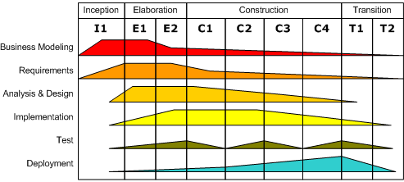
Testing in RUP
RUP considers testing as a distinct iterative discipline, which will be carried out along the development process
Four quality dimensions:
Reliability
Functionality
Application Performance
System Performance.

Slide 33
Agile and Testing
Agile team structure?
In Agile Development it might not be needed to have a separate team of testers
Not having a separate test team does not mean that Agile considers testing to be any less important
Basics of Agile Testing:
Testing can done more effectively in short turn around times, by people who know the system and its objectives very well
Developers write unit tests as part of their coding activity
Business analyst or Product owner to define and in some cases run the acceptance tests
Automated Testing
Can be simple test-running scripts

Slide 34
Test-Driven Development (TDD)
TDD is a software development process that relies on the repetition of a very short development cycle.
Related to the test-first programming concepts of eXtreme Programming in 1999.
Requires developers to create automated unit tests that define code requirements BEFORE writing the code itself.
This type of method has been experienced in CSC108 and other previous programming courses.

Slide 35
Test-Driven Development Cycle
1. Add a New Test
2. Run Tests and Verify New Test
3. Write Code to Satisfy New Test
4. Run Tests and Check Validity
5. Re-factor Code
6. Repeat

Slide 36
Test-Driven Development Cycle
Step 6 - Repeat
Start new test and repeat cycle.
Size of steps should always be small
Step 5
Having test cases already made, gives the programmer confidence to re-factor code.
If errors are made while re-factoring, simple undo can be done.
Step 2
The new test case is run along with previous written cases to verify proper testing.
New test case should fail, or test case is covering wrong feature. Other case results should remain the same as before.
Knowing the case failed reinforces the programmer's confidence that he is on the right path.
Step 3
Code which will satisfy the test case requirements.
Code may not be pretty, but will suffice. In a later step, you will work to improve the code.
Step 4
Run all the test cases.
If all tests pass, programmer can be confident in his code and move on to re-factoring code.
Step 1
Before adding a new feature to a program, write a test case.
Test case should meet feature requirements and specifications.
Helps the programmer focus on requirements before coding.

Slide 37
TDD Process
1. Add a New Test
Before adding a new feature to a program, write a test case.
Test case should meet feature requirements and specifications.
Helps the programmer focus on requirements before coding.
2. Run Tests and Verify New Test
The new test case is run along with previous written cases to verify proper testing.
New test case should fail, or test case is covering wrong feature. Other case results should remain the same as before.
Knowing the case failed reinforces the programmer's confidence that he is on the right path.
3. Write code
Code which will satisfy the test case requirements.
Code may not be pretty, but will suffice. In a later step, you will work to improve the code.

Slide 38
TDD Process
4. Run Tests
Run all the test cases.
If all tests pass, programmer can be confident in his code and move on to re-factoring code.
5. Re-factor Code
Having test cases already made, gives the programmer confidence to re-factor code.
If errors are made while re-factoring, simple undo can be done.
6. Repeat
Start new test and repeat cycle.
Size of steps should always be small

Slide 39
TDD
TDD is a confidence builder and helps programmers focus on the requirements. When a test fails, progress has been made since the programmer knows the correct problem has to be solved. There is a clear measure of success after passing a test. By showing that the function works and meets the requirement, it gives the developer confidence to move on. The point of TDD is to "test with a purpose".
Disadvantages:
False sense of security
All of the tests that developers had written were passed, but they neglected some of the important faults !!
Excessive number of test cases, reduced productivity

Slide 40
Formal Verification

Slide 41
Formal Verification
The proof of correctness of an algorithm based on some assumption using formal mathematical proofs.
Verification
Given a Precondition, prove the Postcondition
Proving that given a set of specifications, your program will produce the expected result
Commonly done both automated and manually by a human
Where is it used?
Very few companies that develop Software
Safety- and Mission-Critical systems
Companies that develop Hardware
Why?

Slide 42
Formal Verification: Two Approaches
1. Model Checking:
Series of steps to exhaustively explore the mathematical model of software
Exploring all states and transitions in the model
To check that the system does not reach the undesirable states
Typically applied to systems with a finite number of states the model can enter
Generalizing infinite state models
The properties to be verified are often described in temporal logics
Linear Temporal Logic (LTL)
Computational Tree Logic (CTL)
2. Logical Inference
Formal version of mathematical reasoning about the system
Usually using theorem proving software (e.g. HOL theorem prover, ACL2)

Slide 43
Final Exam Question – Winter 2010
Yoda Motors uses software to control every aspect of their vehicles. People have recently been killed due to a suspected problem somewhere in the software (millions of lines of code) which causes the car to accelerate uncontrollably and not respond to any input. You have been recruited by the government to investigate the software engineering practices at Yoda Motors. The government has given you ultimate power during this audit, and all engineers, testing facilities, vehicles, and code is fully at your disposal to do whatever you want. Your job is to determine whether or not Yoda Motors has done the best job humanly possible to build safe software in the life-critical parts of the code.
What will you do to determine whether or not Yoda Motors was negligent? How will you tell? What are you looking for?

Slide 44
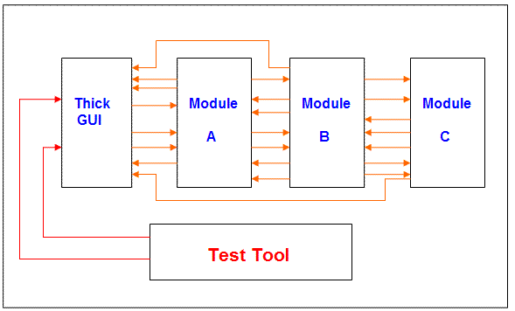
Badly designed systems makes testing difficult
We have a thick GUI that has program logic. The interfaces between the modules are not clearly defined.
Testing of specific functions (Unit Testing) cannot be isolated.
Testing has to be done through the GUI
Testing is difficult.
“Badly designed system”
GUI Test Drivers

Slide 45
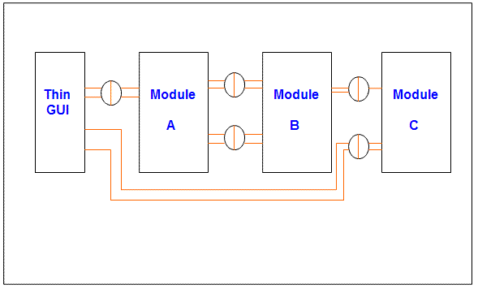
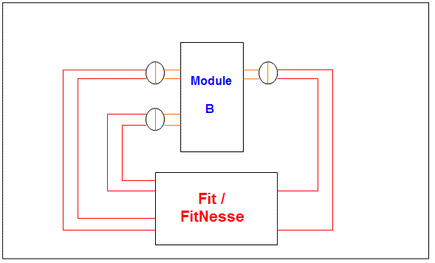
Well architected applications makes testing simple
“Well architected application”
The GUI does not contain any program logic other than dealing with presentation.
The interfaces between the modules are well defined.
This give us testing advantages.
Unit and System acceptance testing are simpler.
When an application has modules with well defined interfaces, each module can be tested independently from the other modules.
Using this type of environment the developer can test the module to make sure everything is working before trying to integrate it with other modules.

